Slide 1
SCS 3214 Group Project II
Group 25
G25

Slide 2
UCSC Virtual Career Fair Management
System
G25

Slide 3
Our Team
G25
Supervisor: Dr (Ms) L N C De Silva
Co-Supervisor: Mr.Roshan Abeyweera
Client: Miss. Nimali Wasana
P. H. Mallikarachchi 2018CS099 18000991
H.T.P.C. Sooriyabandara 2018CS164 18001645
H. P. N. Aravinda 2018CS015 18000152
W.G.S.L.Bandara 2018CS023 18000231
R. L. Udayanga 2018IS085 18020852

Slide 4
Introduction:
G25
The essential goal is to conduct and manage the UCSC virtual career fair for the PDC of UCSC
This system is to handle the UCSC career fair program by connecting all the stakeholders, including companies, PDC, final year undergraduates, and graduates.
We are going to offer a web-based software program system for PDC to handle candidate and company registration.
Companies can publish their advertisements.
Candidates can submit CVs, receive information relevant to job vacancies and apply for related job vacancies.
System facilitate companies to schedule and conduct career interviews during a specific period (Career Week).
System generate numerous reports required by PDC .

Slide 5
Problem definition:
G25
There is an existing career fair system in ucsc and it can only upload the Cv and companies can post the advertisement and it only allows registration for both student and company.
The career fair organized by the fourth-year students and PDC is one such activity that had a significant impact due to the banning of gatherings and social distancing. During the past few years, the career fair was done physically at UCSC in the presence of limited resources.
However, due to the space limitations in the physical setting, a limited number of companies were given the opportunity to participate in the career fair as well.
Conducting a virtual career fair is the best solution in the current context.
This will also address the issue of limiting the number of participants including both candidates and companies in the physical setting. Our solution to this problem is developing a complete software system connecting PDC, IT companies, graduates, and the final year undergraduates to virtually handle the UCSC career fair program.

Slide 6
Goals & Objectives:
G25
Goals
make a platform where virtual career fairs can be organized and conducted amidst the current situation in the country while adhering to physical distancing.
The virtual nature will also allow a broader community, both companies, and candidates to participate in the event without any significant restrictions.

Slide 7
Objectives
G25
Connect all stakeholders, including companies, PDC, final year undergraduates, and graduates,
handle candidate and company registration,
Facilitate the graduates and the final year undergraduates of UCSC to submit CVs, receive information relevant to job vacancies, and apply for related job vacancies,
CV shortlisting and facilitate companies to schedule and conduct career interviews during a specific period (Career Week),
Generate numerous reports required by PDC for decision-making purposes and increase the traceability within the whole process.

Slide 8
Project Scope:
G25

Slide 9
G25
We are planning to provide these functionalities through the system,
● Company Registration
● Student Registration
● Collecting vacancy advertisement from registered companies
● Sorting collected advertisements according to the job role
● Allow students to upload their CVs according to their preferences
● Update about current status on job vacancies.
● Update about current status on each student's availability.
● Create reports about each process
● Make notifications about interviews.

Slide 10
Quality Attributes
G25
Security
Modifiability
Usability
Availability
Reusability

Slide 11




Proposed Technologies
G25
Frontend
Backend
Database
version control
React
Node.js
MySQL
Git

Slide 12
Feasibility study:
G25
Technical Feasibility
Provide response for any user
Operational Feasibility
Easy to handle the system
All users have IT background
Most of user requirements are fulfiled
Users can enroll with the system under the restrictions provide with system

Slide 13
G25
Economical Feasibility
UCSC project
Service project
Free host server and free web development tools
No any financial cost
No need specific hardware componets to works
Legal Feasibility
Confidential and privacy of information

Slide 14
G25
Schedule Feasibility
Suppose to complete within 15 weeks and deploy.

Slide 15
Time Estimation:
G25

Slide 16
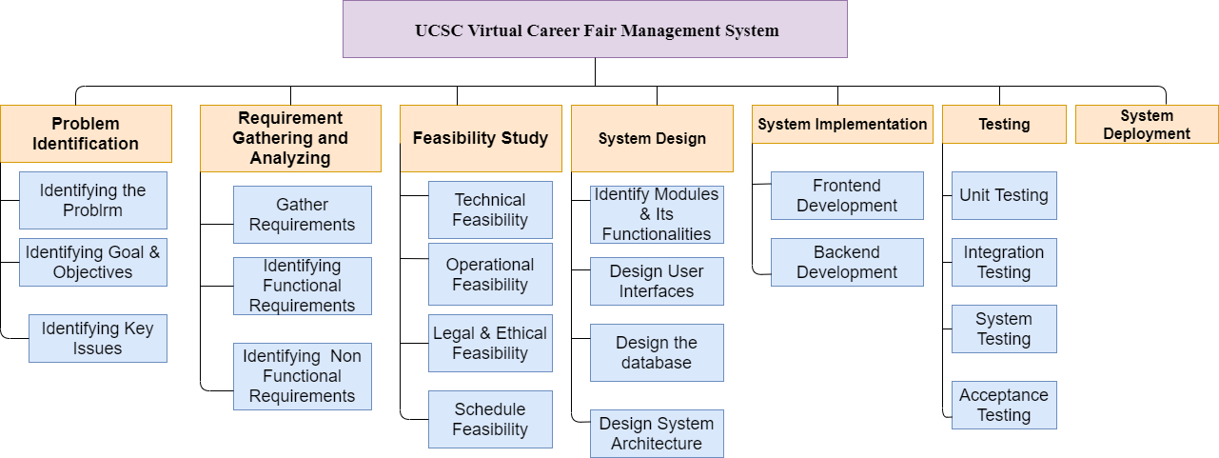
G25

Slide 17
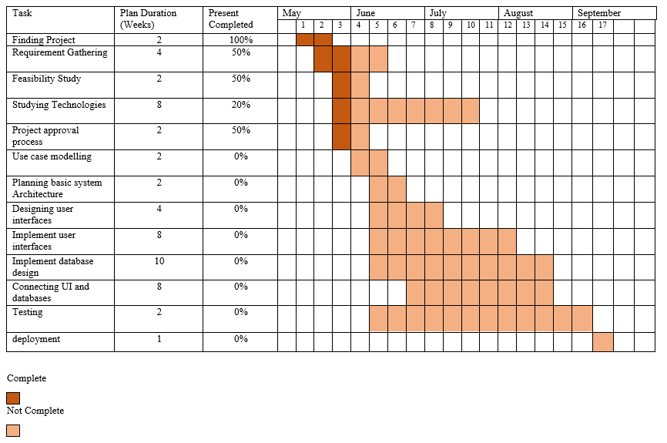
G25

Slide 18




System Actors
G25
Student Company Admin Organizer

Slide 19
Thank you !
G25

